Slide 1
Chapter 5
Supply

Slide 2
Chapter 5, section 1

Slide 3
Understanding Supply
Supply is the amount of goods and services available.

Slide 4
Understanding supply
Law of Supply is the principle that suppliers will produce larger quantities of goods at higher prices. Ex. If a price of a good increases, firms will produce more to earn extra revenue and new firms will enter into the market.

Slide 5
Understanding supply
Supply schedule is a chart that lists how much of a good a individual supplier will offer at different prices.

Slide 6
Understanding supply
Supply curve- a graph that shows the quantity supplied of a good at different prices. The line always rises from left to right.

Slide 7
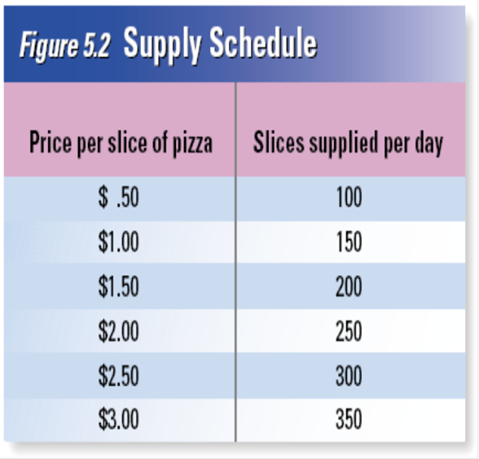
Understanding supply
Market supply schedule- a chart that lists how much of a good all suppliers will offer at different prices.

Slide 8
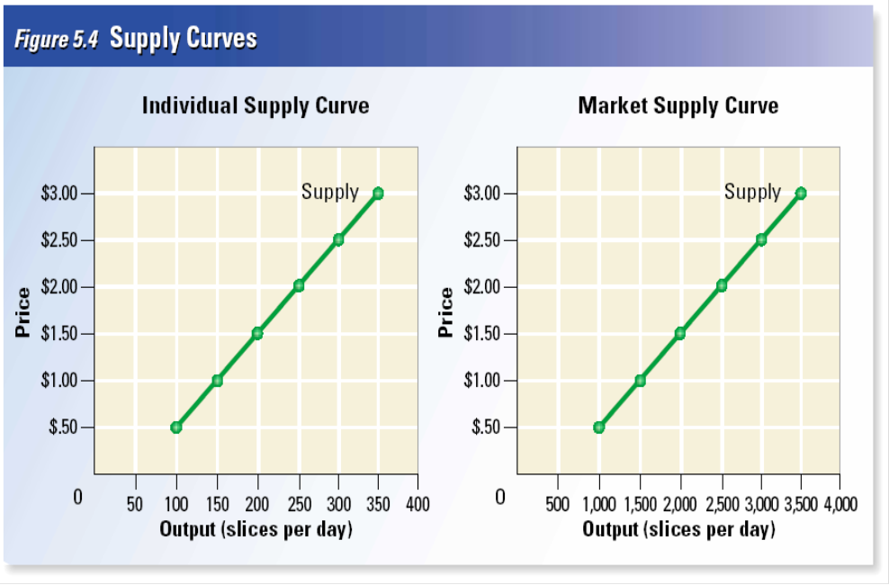
Understanding supply
Market supply curve- a graph of the quantity supplied of a good by all suppliers at different prices.

Slide 9
Understanding supply
Supply elasticity- is the measurement of the effect of price change on the amount of a product that a supplier makes.
If a products price increases and supply increases quickly than it has elastic supply

Slide 10
Understanding supply
If production takes a long time to adjust to price increase, then product has a inelastic supply.

Slide 11
Chapter 5
Section 2

Slide 12
Cost of Production
Entrepreneurs need to consider marginal benefits and costs when deciding how much output to produce.
Marginal product of labor is the change in output from hiring 1 more additional unit of labor. (How much more stuff is produced with additional employees.)

Slide 13
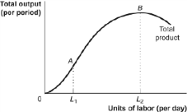
Cost of production
As an entrepreneur invests in more labor, while keeping capital constant, the product of labor first increases then falls.

Slide 14
Cost of Production
Increasing marginal returns- marginal product of labor increases as the number of workers increase. (Output increase with more workers.)
Diminishing marginal returns- a level of production where the marginal product of labor decreases as the number of workers increase. (Output decreases with more workers.)

Slide 15
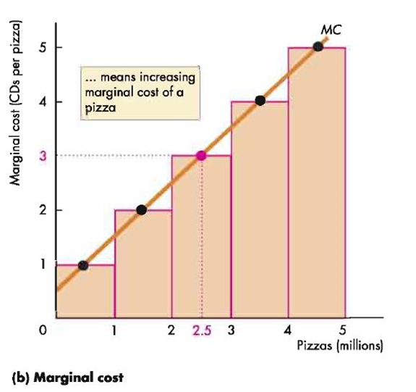
Cost of Production
The most profitable level of output is where marginal revenue, the additional income from selling 1 more unit of a good is equal to marginal cost, the cost of producing 1 more unit of a good. Cost to make = price of product

Slide 16
Chapter 5
Section 3

Slide 17
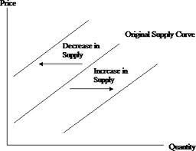
Changes in Supply
Several non- price factors can raise or lower the supply of a good at all prices, or cause it to shift to the left or right.
1. Input costs- when inputs (resources) become more expensive, supply falls and the supply curve shifts to the left. If inputs become cheaper, supply rises and shifts to the right.

Slide 18
Changes in supply
2. Technology- new technology can lower the cost of production and increase supply, shifting curve to the right.

Slide 19
Changes in supply
3. Government regulation- government encourages suppliers to produce more with subsidies or government money given to a business or market in order to increase supply.
Government can also reduce supply with excise taxes, which is a tax on the production of a good. Ex. Cigarettes

Slide 20
Changes in supply
Other factors that affect supply are: worker productivity, price expectations, the number of suppliers in the market and competition from foreign suppliers.
If sellers expect the price of goods they have to increase dramatically in the future, they will store the goods until the price rises

