Slide 1
9 Principles of economics

Slide 2
People choose
Economics is about choosing from alternative ways to use scare resources to accomplish goals
All economic analysis focuses on how people choose

Slide 3
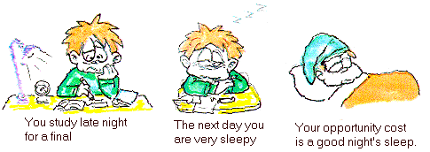
Every choice has a cost
The economist’s concept of cost is something that is given up when choosing something else
The alternative that was given up is the cost of the choice called “opportunity cost”
Opportunity costs is not all of the alternatives you could have selected; it is what is lost by the choice you did make

Slide 4
Benefit/cost analysis is Useful
Every choice we make involves benefit/cost analysis, either implicitly or explicitly
There are 5 steps in the benefit/costs analysis. They are:
-Identify the goal and resources available to achieve the goal
-Identify alternative ways to achieve the goal and narrow down the options
-Evaluate the advantages and disadvantages of each option
-Choose one of the alternatives
-Identify the alternative not selected as the opportunity cost

Slide 5
Benefit/cost analysis is useful
Wage: $8.00
Incentives: Free movies, soda and popcorn
Hours: 15-20
Holiday Pay: Time and a half on 3 holidays
No health insurance
I love this job
Wage: $8.30
Incentives: Five percent off all items purchased
Hours: 30
Holiday Pay: Double time on 6 holidays
Health insurance
This one, not so much
Movie Theater
Albertson’s

Slide 6
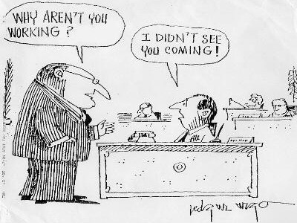
Incentives matter
Wealth is subjective evaluation of one’s well-being, not an amount of money i.e. you won’t choose something if there is no incentive!

Slide 7
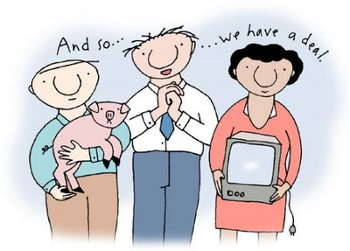
Exchange benefits the traders
Two parties with equal information will voluntarily exchange only if they gain more than they give

Slide 8
Markets work with competition, information, incentives and property rights
An economy accomplishes two tasks:
-Production of goods and services desired by society
-Facilitation of exchange between parties
Profit is the major incentive of a market economy and competition is the major regulator

Slide 9
Skills and knowledge influence income
Employers will hire workers if the employers expect to gain more than they give
Employers will give high salaries if they expect the revenue to be brought in higher than the amount being paid to the individual

Slide 10
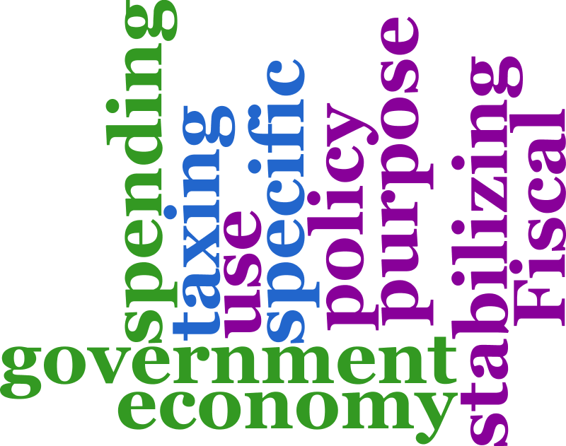
Monetary and fiscal policies affect people’s choices
The three goals of macroeconomic policy are economic growth, full employment and price stability

Slide 11
Government policies have benefits and costs
Government policies always involve trade-offs
When governments use resources there is an opportunity cost
The benefits and the opportunity cost of particular policies are not always evenly distributed

